Slide 1
Quantization of Vision-Language Model for Remote Sensing Visual Grounding
Student Name:
Shamma Alblooshi (100045387)
Suhail Almarzouqi (100045490)
Tasneim Aldhanhani (100048765)
Instructor:
Dr. Hasan Al Marzouqi
Course:
Vision Language Models – COS 794
29 APRIL 2025

Slide 2
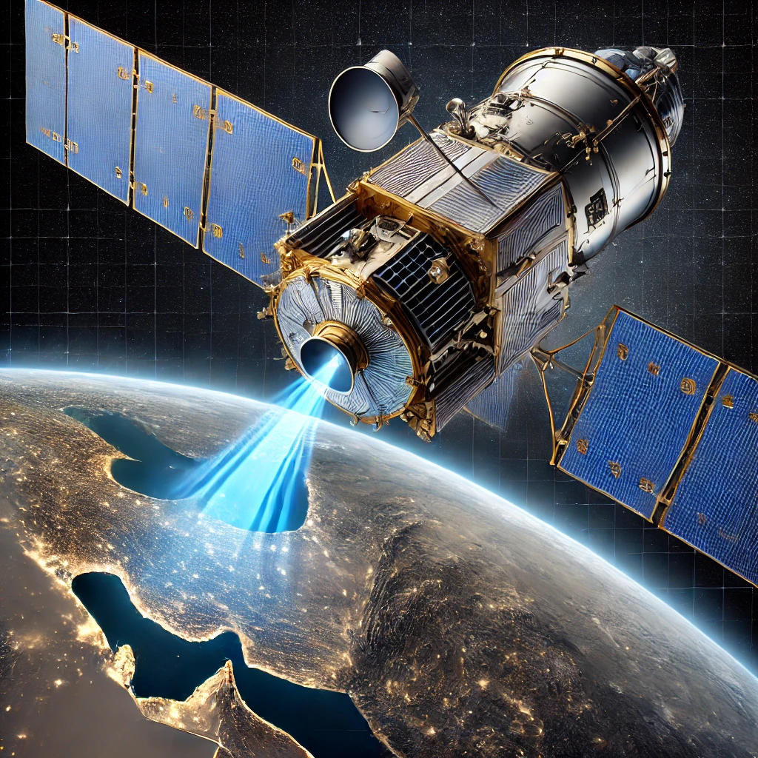
Outline
01
Problem Definition and Motivations
02
Methodology
03
Results and Discussion

Slide 3
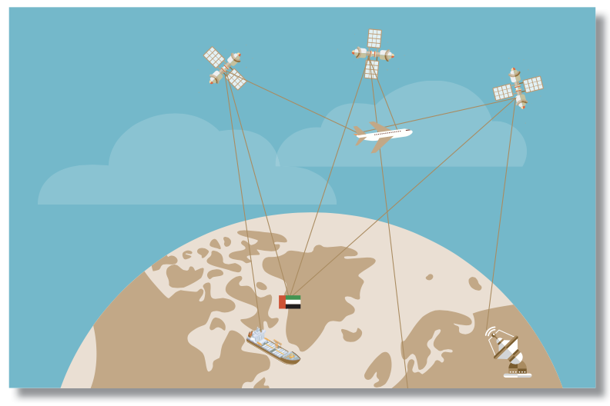




Problem Definition and Motivations
Why RSVG?
Who Cares
What are we trying to do?
Quantize and optimize pretrained VLMs to improve computational efficiency for RSVG, without retraining.
Select and benchmark baseline VLMs (e.g., MDETR, CLIP-based detectors).
Integrate quantization techniques (e.g., 8-bit, 4-bit mixed precision) to compress model, speed up inference, and save memory.
Benchmark grounding performance before and after quantization across remote sensing datasets.
Analyze trade-offs between accuracy, inference speed, and model size.
Advance scalable, deployable multimodal AI models for RS imagery understanding.
What’s New?
Earth observation satellites and UAVs generate massive high-resolution RS imagery.
Extracting actionable insights is critical for:
Disaster response
Urban planning
Agriculture monitoring
Military applications.
Visual Grounding enables flexible, open-world object localization from natural language queries beyond static object categories.
RSVG supports real-time, dynamic scene understanding for diverse remote sensing platforms.
Notes:
The rise of Earth observation satellites generates vast remote sensing data.
Extracting insights is key for disaster response, urban planning, Agricultural assessment, Military applications and monitoring.
Visual Grounding enables the localization of objects or regions in RS images based on natural language queries, rather than fixed object categories, supporting open-world target identification.
Remote Sensing Visual Grounding is essential for enabling flexible, dynamic, real-time scene understanding from orbit or UAV platforms.

Slide 4
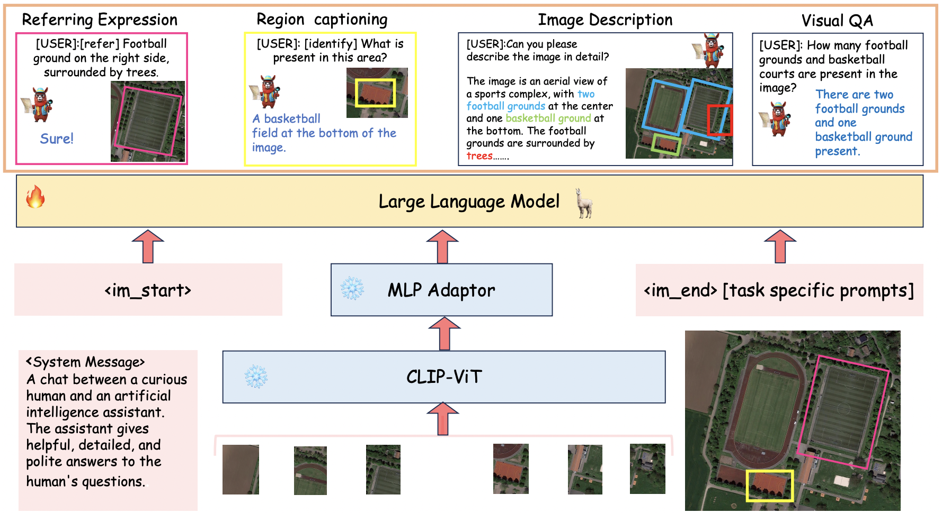
Methodology
GeoChat Model
GeoChat Model Architecture
Built upon LLaVA-1.5 framework, adapted for remote sensing.
Visual Encoder: CLIP-ViT (enhanced for 504×504 remote sensing images).
MLP Adaptor: Projects visual features to LLM space.
Language Model: Vicuna-7B with LoRA fine-tuning for instruction-following.
Task Tokens: [grounding], [identify], [refer] inserted to control output behavior.
Spatial Representation: Bounding boxes encoded as normalized text strings (with optional rotation).
What’s New?
What’s New?
Project Objectives
Quantize the pretrained GeoChat model to achieve efficient, scalable remote sensing visual grounding (RSVG) , improving inference speed, memory footprint, and deployability without retraining.
Pipeline:
Baseline: Evaluate GeoChat's performance in BF16 precision (Brain Float 16).
8-bit Quantization: Apply Bits and Bytes asymmetric quantization (LLM.INT8) for model compression.
4-bit Quantization: Further compress using QVLM custom techniques based on Bits and Bytes.
Purpose: Adapt VLMs for remote sensing imagery with: Top-down views, multi-scale targets, cluttered scenes.
Notes:
We start with the GeoChat model, which is the foundation of our system. GeoChat is a remote-sensing VLM built upon the LLaVA-1.5 framework but adapted for remote sensing. It has the same architecture of LLava.

Slide 5
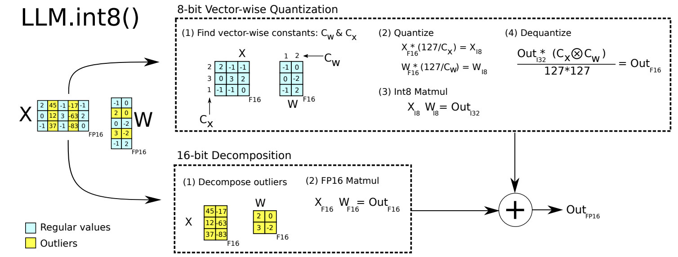
Quantization Methods
8- bit quantization pipeline
Main components
8-bit Vector-wise Quantization path
Compute per-row / per-column scales : absolute-max values per-row (Cx) and per-column (Cw)
Quantize each row/column independently: multiply the FP16 tensor by 127 / C and round to Int8
MatMul: perform Int8×Int8 → Int32 matrix multiplication
De-quantize back to FP16: multiply the Int32 result by (Cx ⊗ Cw) / (127×127) to recover FP16 accuracy
16-bit path
• Identify the small set of feature dimensions whose magnitudes exceed a threshold , denote their indices by O
• Extract from the activation X and weights W just the columns/rows corresponding to O, full-precision (FP16) mat-mul on those
Finally, you add the two partial outputs (FP16 from the 16-bit and de-quantized FP16 from the Int8 remainder) to get the full matrix-product result.
What’s New?
What’s New?
Goal: In a normal 8-bit quantization you pick one single “scale” per tensor, so every element in the weight or activation shares the same mapping into [−127,127]. LLM.int8() instead treats each row of the activation matrix and each column of the weight matrix as its own mini-tensor, each with its own scale factor.
Notes:
So the main idea of this is that in large transformers, a tiny fraction of feature dimensions—about 0.1%—produce exceptionally large values that are critical to model performance but get mangled by standard vector-wise quantization, which treats each hidden-state row uniformly.
To handle them, we introduce a mixed-precision decomposition: they first identify all feature indices whose values exceed a threshold (we found α = 6.0 works well), then split the matrix multiplication into two parts.

Slide 6
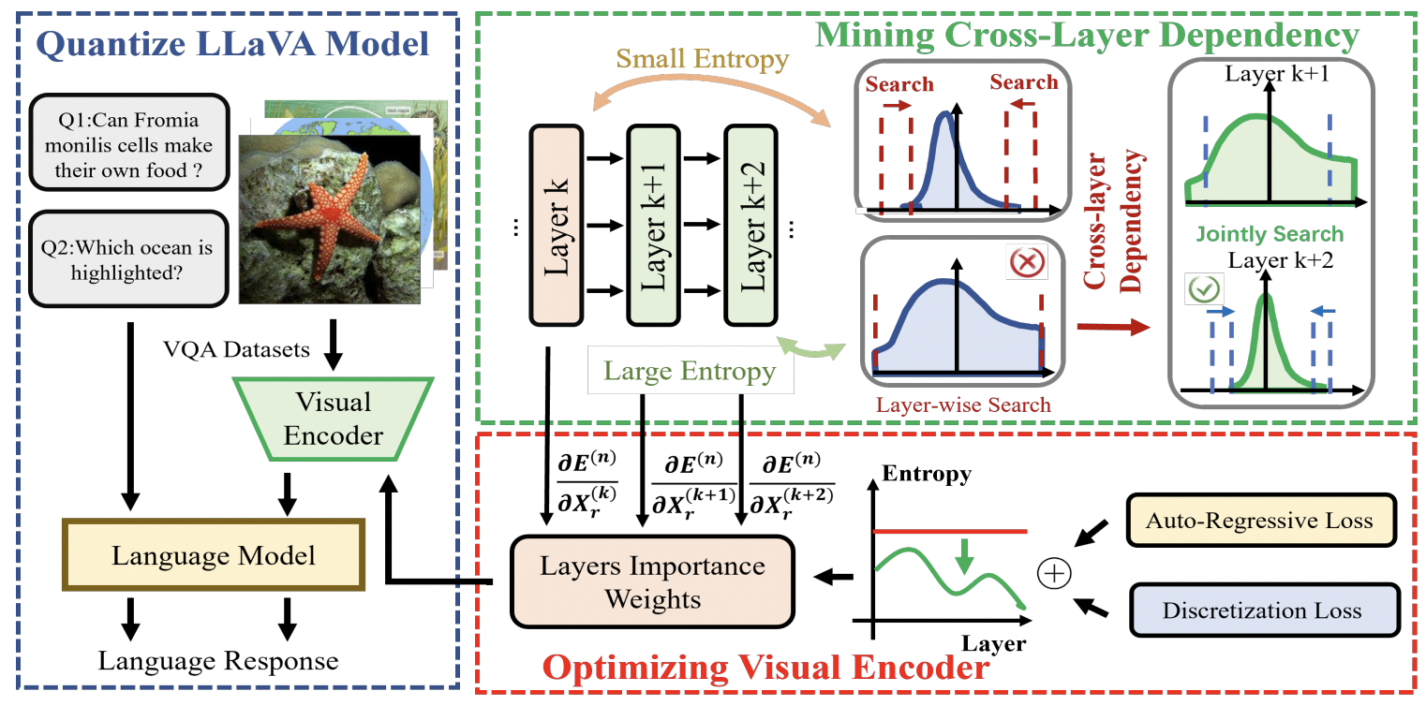
Quantization Methods
QVLM pipeline
Main components
Mining Cross-Layer Dependency
They scan through layers in order. Whenever layer k and k+1 both have high entropy (above some threshold T), they glue them (and any intermediate high entropy layers) into one joint block. Wherever entropy is low, they allow a “cut” and treat that layer in its own block.
For each block ,search for the best 4-bit clipping and rounding parameters that minimize the block’s output error versus its original FP output.
Optimizing the visual encoder
Auto-regressive loss: Freeze the language model but still compute its usual next-token cross-entropy so that the whole system continues to produce sensible answers.
Discretization (clipping) loss: encourages its activations to lie in narrow, low-dynamic-range bands (making them easier to quantize).
By back-propagating these objectives alongside the original auto-regressive language loss, the encoder learns to produce features whose quantization errors no longer cascade strongly through the network.
What’s New?
What’s New?
Goal: Convert every weight and activation in a pre-trained LLaVA model from 16-bit (or 32-bit) float down to pure 4-bit integers.
What they do :
Leave all model weights frozen and choose a small “calibration set” of (image, question) pair, just a few dozen VQA examples.
Search for the optimum 4-bit clipping/range parameters per block of layers (not per layer!), so that the difference between the block’s 4-bit output and its original floating‐point output is as small as possible.
Notes:
The goal here is: “Convert every weight and activation from 16/32 bit floats down to pure 4-bit integers, block by block.” If you simply round each layer’s tensors to 4 bits independently, tiny rounding errors accumulate through the 200+ transformer layers, and by the time you reach the output you’ve drifted so far that the model hallucinating nonsense.
Entropy as a Dependency Signal
•Observation: In a transformer, some layers produce very peaky activations (low entropy)——and other layers produce a flat, spread-out activation histogram (high entropy).
Key empirical fact: Whenever a layer’s output has high entropy, any small rounding mistake in that layer tends to wildly throw off all subsequent layers. In contrast, low-entropy layers tolerate local rounding mistakes with almost no downstream effect.

Slide 7
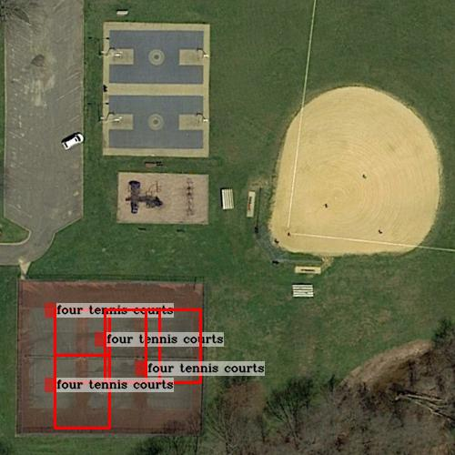
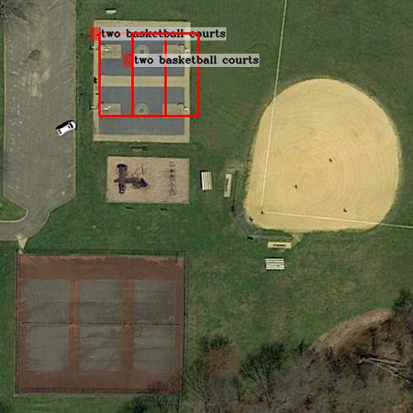
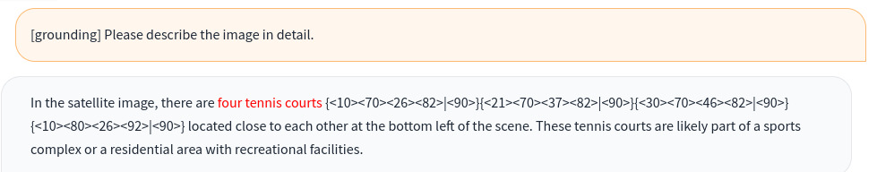
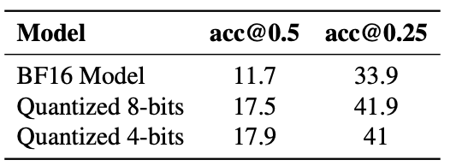
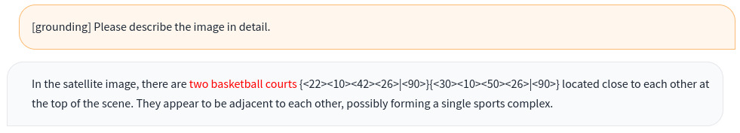
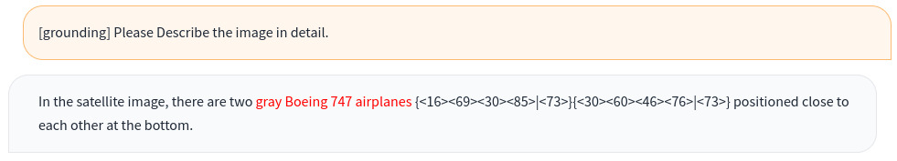
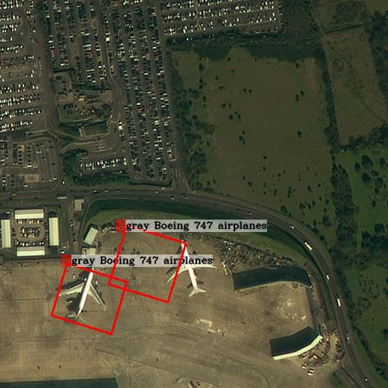
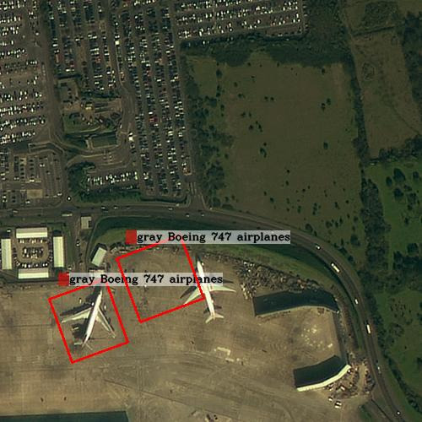

Results and Discussion
Visual Grounding
Key Findings
8-bits RSVG
4-bits RSVG
Table 1: Grounding description task.
8-bits Visual Grounding
Quantization improved performance: Reducing model precision introduced slight regularization, stabilizing outputs and improving generalization. As a result, both 8-bit and 4-bit quantized models outperformed the original BF16 baseline.
Counting accuracy generally preserved: 4-bit and 8-bit models correctly counted major objects (e.g., airplanes, basketball courts), though the 8-bit model overcounted tennis courts. Minor scene differences appeared under the same query.
Minor localization shifts: 4-bit models showed slight bounding box looseness but maintained coherent grounding and descriptions.
4-bits Visual Grounding
8-bits RSVG
4-bits RSVG
What’s New?
8-bits Visual Grounding
4-bits Visual Grounding
Notes:
Quantization improved grounding performance: 8-bit and 4-bit quantized models outperformed the original BF16 baseline in remote sensing visual grounding, showing higher accuracy at both IoU@0.5 and IoU@0.25 thresholds.
Counting accuracy generally preserved: The 8-bit quantized model overcounted the number of tennis courts (detecting four courts where only three were present), while correctly counting two Boeing airplanes. The 4-bit models preserved counting accuracy for major objects such as airplanes and basketball courts. Minor differences in scene interpretation were observed even when the same query was provided.
Minor localization differences observed: 4-bit models occasionally showed slight shifts or looseness in bounding box placement compared to 8-bit models, but overall spatial grounding and descriptive coherence were maintained.
Compression impact minimal: Moving from 8-bit to 4-bit quantization resulted in negligible accuracy loss while significantly reducing model size and computational cost.
Supports scalable deployment of vision-language AI: Results demonstrate that aggressive quantization enables lightweight, deployable VLMs for real-time or near-real-time remote sensing applications without major degradation in visual grounding quality.

Slide 8
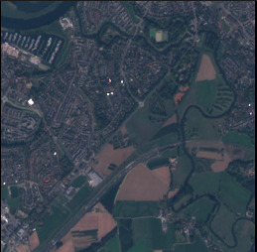
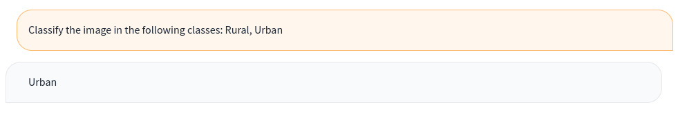
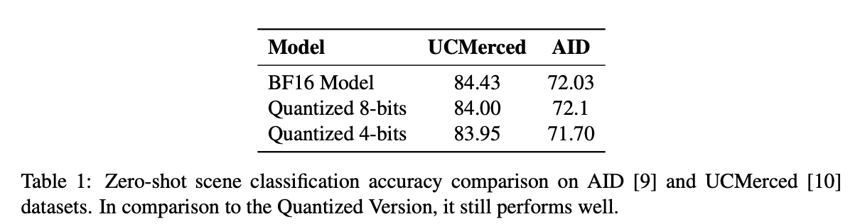
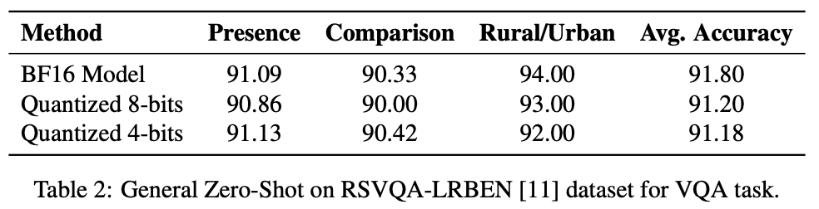
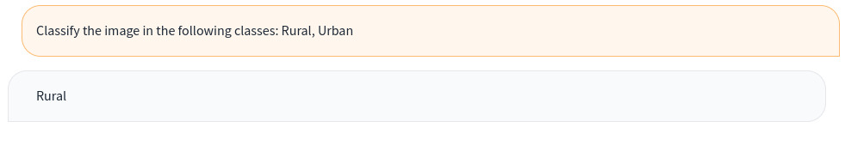
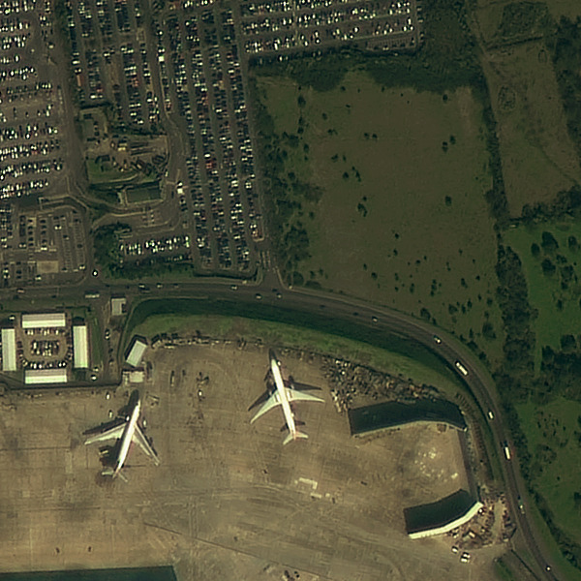
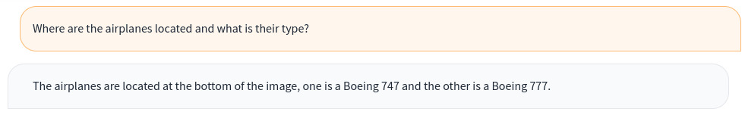
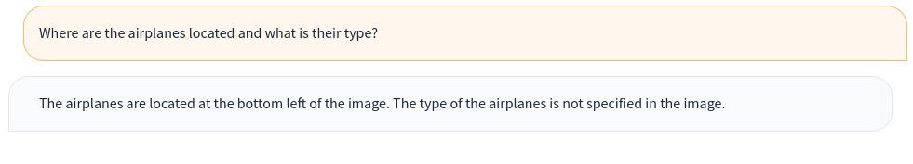
Results and Discussion
Zero-shot scene classification
Key Findings
Table 2: Zero-shot scene classification
Table 3: Zero-shot RSVQA
8-bits Scene Classification [Correct]
Scene classification robustness preserved: 8-bit and 4-bit models maintained near-baseline accuracy on UCMerced and AID, with negligible drops (<0.5%).
Minor misclassifications under 4-bit: While 8-bit models correctly classified urban vs rural scenes, 4-bit models occasionally misclassified under ambiguity, reflecting slight sensitivity at extreme compression.
Stable zero-shot RSVQA performance: 8-bit and 4-bit models matched or slightly exceeded BF16 in question answering tasks.
Partial answers at 4-bit: 4-bit models sometimes omitted detailed types (e.g., "Boeing 747") in answers.
Minimal overall impact: Compression preserved strong zero-shot generalization for both scene classification and RSVQA.
4-bits Scene Classification [Misclassified]
Zero-shot RSVQA
What’s New?
8-bits RSVQA [Full Answer]
4-bits RSVQA [Partial Answer]
Notes:
Scene classification robustness preserved: Quantized 8-bit and 4-bit models maintained comparable zero-shot scene classification accuracy on UCMerced and AID datasets, with negligible drops (<0.5%) compared to the BF16 baseline.
Minor misclassifications under 4-bit: While 8-bit models correctly classified urban vs rural scenes, 4-bit models occasionally misclassified under ambiguity, reflecting slight sensitivity at extreme compression.
Zero-shot RSVQA performance stable: Both 8-bit and 4-bit models achieved similar or slightly better average accuracy compared to the BF16 model in visual question answering tasks
Partial answer generation at 4-bit: The 4-bit model sometimes produced partial answers (missing specific type names like "Boeing 747"), reflecting minor degradation in detailed reasoning after aggressive quantization.
Minimal overall impact from compression: Despite slight descriptive losses, 8-bit and 4-bit quantized models preserved strong zero-shot generalization ability for both scene classification and RSVQA, supporting efficient deployment.

Slide 9
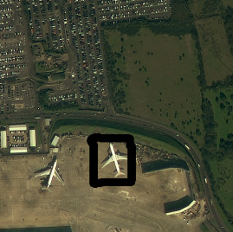
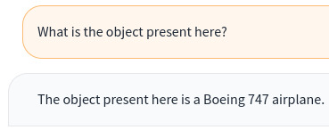
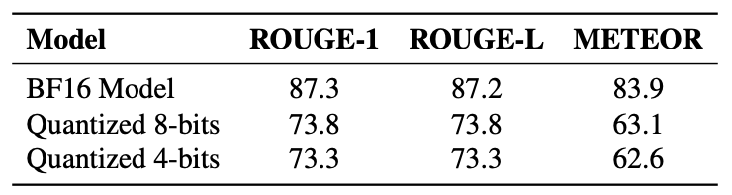
Results and Discussion
Region level captioning
Key Findings:
Correct region-level grounding: Both 8-bit and 4-bit models correctly captioned the object (Boeing 747 airplane) despite compression.
Performance drop after quantization: Quantized models showed lower ROUGE-1, ROUGE-L, and METEOR scores compared to the BF16 baseline, reflecting reduced fluency and lexical match.
Minimal difference between 8-bit and 4-bit: 4-bit models preserved similar captioning quality to 8-bit, with only slight additional score degradation.
Content understanding preserved: Although textual overlap metrics decreased, the main semantic content (object identity) remained accurately captured across quantization levels.
8-bits Region Captioning [Correct]
4-bits Region Captioning [Correct]
Future Development:
Table 4: Region level captioning performance
Enhance quantization techniques: Investigate more advanced quantization strategies to further reduce model size while minimizing performance loss.
Address detailed reasoning degradation: Explore methods such as selective fine-tuning or knowledge distillation to mitigate partial answer generation and improve fine-grained reasoning after compression.
Improve spatial grounding precision: Develop calibration or post-processing methods to reduce minor bounding box shifts observed after aggressive quantization.
Adapt quantization for new RS tasks: Extend quantization experiments to additional remote sensing tasks such as change detection

Slide 11
Reference
Y. Zhan, Z. Xiong, and Y. Yuan, “Rsvg: Exploring data and models for visual grounding on remote sensing data,” IEEE Transactions on Geoscience and Remote Sensing, vol. 61, pp.1–13, 2023.
Y. Zhou, M. Lan, X. Li, Y. Ke, X. Jiang, L. Feng, and W. Zhang, “Geoground: A unified large vision-language model for remote sensing visual grounding,” 2025. [Online]. Available: https://arxiv.org/abs/2411.11904
Hugging Face, “Optimum: A Guide to Quantization,” 2024, available at: texttthttps://huggingface.co/docs/optimum/en/concept guides/quantization, Accessed: Feb.10, 2025.
M. Grootendorst, “A Visual Guide to Quantization,”https://newsletter.maartengrootendorst.com/p/a-visual-guide-to-quantization, 2024, accessed: Feb. 10, 2025.
L. Tunstall, L. von Werra, and T. Wolf, Natural Language Processing with Transformers, Revised Edition. O’Reilly Media, 2022. [Online]. Available:https://www.oreilly.com/library/view/natural-language-processing/9781098136789/
K. Kuckreja, M. S. Danish, M. Naseer, A. Das, S. Khan, and F. S. Khan, “Geochat:Grounded large vision-language model for remote sensing,” 2023. [Online]. Available:https://arxiv.org/abs/2311.15826
C. Wang, Z. Wang, X. Xu, Y. Tang, J. Zhou, and J. Lu, “Q-vlm: Post-training quantization for large vision-language models,” 10 2024.
T. Dettmers, M. Lewis, Y. Belkada, and L. Zettlemoyer, “Llm.int8(): 8-bit matrix multiplication for transformers at scale,” 2022. [Online]. Available: https://arxiv.org/abs/2208.07339
G.-S. Xia, J. Hu, F. Hu, B. Shi, X. Bai, Y. Zhong, L. Zhang, and X. Lu, “Aid: A benchmark data set for performance evaluation of aerial scene classification,” IEEE Transactions on Geoscience and Remote Sensing, vol. 55, no. 7, pp. 3965–3981, 2017.
Y. Yang and S. Newsam, “Bag-of-visual-words and spatial extensions for land-use classification,” in Proceedings of the 18th SIGSPATIAL International Conference on Advances in Geographic Information Systems, ser. GIS ’10. New York, NY, USA: Association for Computing Machinery, 2010, p. 270–279. [Online]. Available: https://doi.org/10.1145/1869790.1869829

